Slide 1



Practice Hour
Housing Solutions Discussion
Date: Thursday 8th August 2024
Name of Facilitators:
Andy Kazim, Anglicare WA, Community of Practice
Home Stretch WA Providers
OP-TR-036-Home Stretch WA – Transient Youth & Housing – Practice Hour - Slides V1.0 Review Date: 01/08/27

Slide 2

Acknowledgement
of Country
Ngaala kaaditj Noongar moort
Keyen kaadak nidja boodja
We respectfully acknowledge the Whadjuk people of the Noongar Nation as the Traditional Custodians of the land we are presenting from today, and all the countries where people are located. We pay our respects to their strength, cultural resilience and the Elders past and present.
Notes:
Perth – Boorloo

Slide 3




Housekeeping & Rules of Engagement
Rules of engagement:
Safe, secure, confidential space
De-identify your examples (including case managers & District offices)
Not supervision (but can be arranged!)
Teams Etiquette:
Cameras on
Mic on mute
Raise your hand (virtually or give us a wave!)
One person per camera is best
Is everyone ok with it being recorded?

Slide 4


Who is here today?
In 1 minute or less
What is your name?
Which agency do you work with?
What is your role?
Which country are you tuning in from?

Slide 5
By the end of this session…
  Resources Available through Home Stretch WA for Housing
  Innovative Use of the Housing Allowance
  Hear from other Home Stretch Providers on how they have used Housing Allowance
Next Practice Hour:
Thursday 22nd August 2024- Provider Led Practice Hour- Streeties

Slide 6

Notes:
Home Stretch provides YP with a Safety Net of support which can be drawn on the support YP experiencing homelessness/transient housing – draws on all parts of the model.
To the group: Hands up if you are currently supporting a YP who is homeless or transient?

Slide 7


  Invest In Me (Pooled Brokerage) - short term, phone credit , vouchers
  Transition Coach – budgeting, housing pathway planning
  Support Circles- explore current/past connections
  Mainstream Resources
  Youth Allowance ($562 f/n) and Rent Assistance ($157)
  Abstudy Residential Costs (Can fully cover student housing)
  TILA Grant ($1500)
Year of SO or HA Payment | Base Rate | Country Loading 10% Mid-West and Goldfields | Country Loading 20% Pilbara and Kimberley
Year 1 | $463.50 | $509.85 | $556.20
Year 2 | $347.63 | $382.39 | $417.15
Year 3 | $231.75 | $254.93 | $278.10
Notes:
Stats are from 2020.

Slide 8
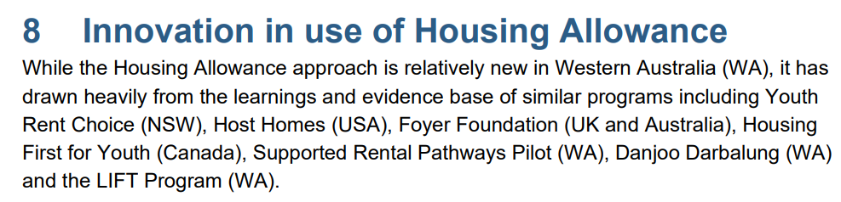

Housing Allowance- Flexible Payment
  Co Design of Housing Allowance identified housing supply would be a challenge at scale.
  Intended to be flexible
  Explore opportunities- submit a proposal
Notes:
Stats are from 2020.

Slide 9

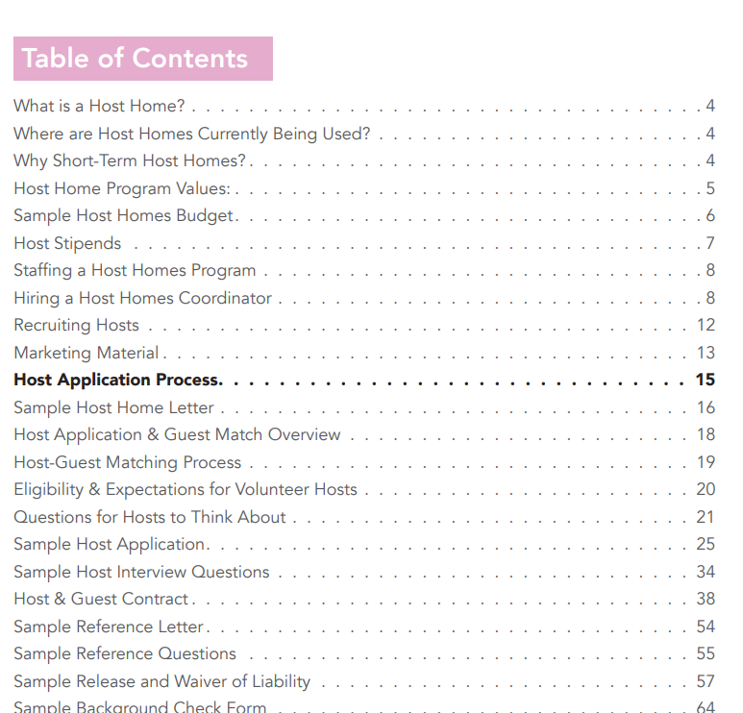
https://www.pointsourceyouth.org/interventions/host-homes
Host Homes
Notes:
Stats are from 2020.

Slide 10
Head Leasing & Establishing Share Housing
  Head Leasing involves a service provider or organization leasing a property from a private landlord or housing provider and then subleasing it to a young person in need of housing.
  This arrangement allows the organization to manage the tenancy and provide support to the young person, ensuring stability and appropriate living conditions.
  The housing allowance helps cover the rental costs, additional support costs, and the costs of the organization overseeing the lease
Notes:
Stats are from 2020.

Slide 11


Village 21
  Youth Supported Accommodation & Transitional Housing | Village 21 (kuc.org.au)
Notes:
Stats are from 2020.

Slide 12
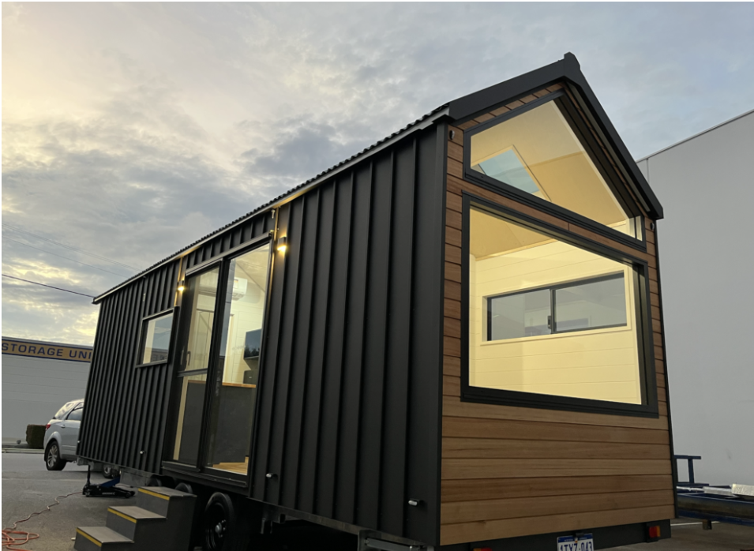
Rotary Supporting "My Home" | Rotary Club of Osborne Park (rotaryosbornepark.org.au)
Tiny Homes Perth, Western Australia | The Tiny Home Evolution
Tiny Homes
  Tiny Homes
  Rotary Club Trial for Home Stretch (more info to come)
Notes:
Stats are from 2020.

Slide 13

Covering other Housing Related Costs
  Housing Allowance is a Flexible Payment that can be used to maintain safe and stable housing
  Where there are other costs they can be considered as part of the subsidy to make the arrangement more affordable
  Electricity, water expenses etc. could be considered as part of other housing costs
  Include them in the Proposal
Notes:
Stats are from 2020.

Slide 14

.
Kimberley Housing Solutions Forum- August 2023
Options Presented
Trial of a Village 21 Style Program in the region
Flexible Use of Housing Allowance for Transient Young People
Head leasing of a house by Provider (refurbished) to create a youth transitional housing property
Collaboration with another service/housing provider to create a Home Stretch specific room/unit/bed in another program.
Notes:
Stats are from 2020.

Slide 15
Covering other Housing related costs
  Emergency and Short-Term Housing should be Covered under Invest In Me
  4 Months was considered
  Housing Allowance
  Electricity, water expenses etc. could be considered as part of other housing costs
  Submit a proposal to Department of Communities for establishing new housing options
Notes:
Stats are from 2020.

Slide 16
.
Important Factors to Consider
Options Presented
Trial of a Village 21 Style Program in the region
Flexible Use of Housing Allowance for Transient Young People
Head leasing of a house by Provider (refurbished) to create a youth transitional housing property
Collaboration with another service/housing provider to create a Home Stretch specific room/unit/bed in another program.
Notes:
Stats are from 2020.

Slide 17

Discussion
What Solutions Have you found in your region/Service ?
  Innovative Housing Solutions?
  Resources/ partnerships ?
  Flexible use of Housing Allowance?
Notes:
Shared responsibility – who can you draw on in the network to be the expert?
Yes Housing! Youth Futures. Horizon House. Yshac.
Support YP to build relationships with new supports in the network.

Slide 18
Examples
  Salvation Army- Utilising existing share housing properties
  Mission Australia- Host Home arrangement Example for Housing Allowance
Notes:
Stats are from 2020.

Slide 19


Questions & Comments?

Slide 20


More Information & Resources
Home Stretch WA Guidelines for Staying On & Housing Allowance
Host Homes Website & Handbook
Village 21
Tiny Homes Rotary Trial
Lift Program – Indigo Junction
Links to Resources & Documents:
www.homestretchwa.org.au

Slide 21


Contact Us
Community of Practice
homestretch@anglicarewa.org.au
Department of Communities
homestretchwa@communities.wa.gov.au

