Slide 1
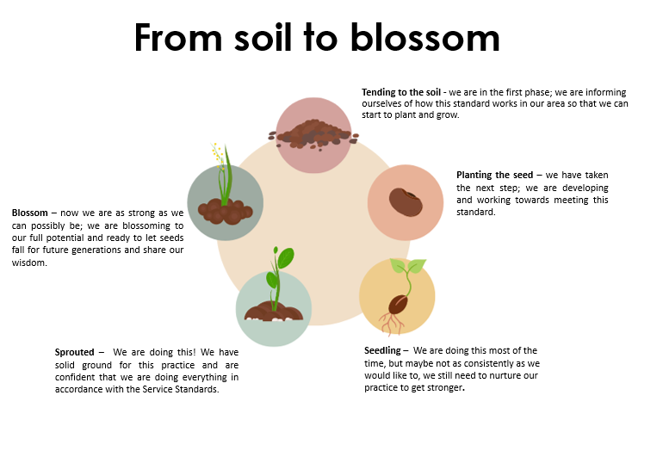
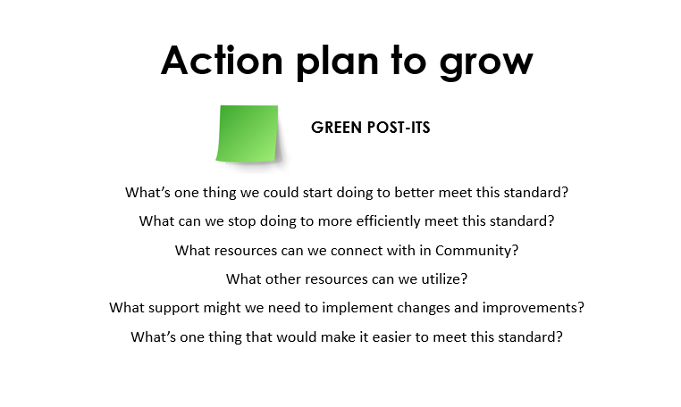
How to Guide
1 |  | The top text explains what the support looks like The bottom text explains what that means for the young person
2 |  | Reflection prompts – these are prompting questions from the Model Integrity Framework to help you understand how you work in accordance with the service standards.
3 |  | Reflect on your Strengths. Write one idea per blue post it and put them all up. Reflect on areas you’d like to grow and develop more within this service standard. Write one idea per red/pink post it and put them all up
4 |  | After your reflection and discussion give yourself a score to represent where you are in your journey in meeting the service standards, from Level 1 – Tending to the soil, to Level 5 - Blossom. Remember it is a safe place to reflect openly in order to grow and learn.
5 |  | These are prompting questions to help create ideas for your continuous improvement, this will provide a platform for your action plan. Write one idea per post it and put them all up.
6 | report | Use the insights and actions from this session to fill out your Model Health Check Document, where you identify areas for improvement, create an action plan and send to Department.

Slide 2
Smooth Transition
From 17.5 years we begin working with a young person and their support circle to ensure a smooth transition of support by 18, and continuity in support through the Home Stretch WA service up to the age of 21.
Young people experience continuity in support and planning and have opportunity to build trust with a Transition Coach over time.

Slide 3
Smooth Transition
From 17.5 years we begin working with a young person and their support circle to ensure a smooth transition of support by 18, and continuity in support through the Home Stretch WA service up to the age of 21.
Developing young people’s confidence and skills in being able to independently access supports and resources from mainstream services by the time they reach 21 years of age.

Slide 4
Reflection Prompts from Service Standards
Communicate Home Stretch – How do we explain Home Stretch to young people and their supports? (for example: info sessions, Flyers, individualizing the offer to the young person, informal connections)
Informed Choice - how do support young people to make an informed choice? (consent, only sharing what young people want shared etc.)
Working Together With Districts for a Smooth Transition - how do we work collaboratively with districts and the young person’s Case Manager, from 17.5 to 18 years? (e.g Co-location, By Name List, meeting with District Champions).
Working Together with Community - How do we connect and build trust with Aboriginal Community Leaders, Elders, Aboriginal Community Controlled Organizations, Aboriginal Practice Leads, and the local Aboriginal community to connect and engage with young people?
Adapting the referral process for our region and community - How have we adapted the referral process to meet regional or remote contexts, or the cultural and language needs of local Aboriginal Communities? What do our location and region-specific resources and client-facing information about the service offer look like?
Smooth Transition
- into Home Stretch 17+

Slide 5
Smooth Transition - continuation of support 21 +
Reflection Prompts from Service Standards
How do we support young people to access resources available to them in the community and build their networks and support circles?
How do we include the young person when creating the Handover Summary document? (Celebrating strengths/ achievements)
How do we support young people to access the leaving care fund independently after 21?
How do we smoothly transition support to specialist services as part of planning after Home Stretch WA, from 20 years of age?

Slide 6
Reflect
STRENGTHS
What are we doing well in this practice area?
What works well in our Community?
What is the key to our success?
Why are we unique?
OPPORTUNITIES FOR GROWTH
What practice can we improve?
How can we develop a stronger practice?
What more could we do? What can we do less?
What are others doing that can inspire us?
WRITE ONE IDEA PER POST IT NOTE

Slide 7
From soil to blossom
Tending to the soil - we are in the first phase; we are informing ourselves of how this standard works in our area so that we can start to plant and grow.
Planting the seed – we have taken the next step; we are developing and working towards meeting this standard.
Blossom – now we are as strong as we can possibly be; we are blossoming to our full potential and ready to let seeds fall for future generations and share our wisdom.
Sprouted – We are doing this! We have solid ground for this practice and are confident that we are doing everything in accordance with the Service Standards.
Seedling – We are doing this most of the time, but maybe not as consistently as we would like to, we still need to nurture our practice to get stronger.

Slide 8
Action plan to grow
GREEN POST-ITS
What’s one thing we could start doing to better meet this standard?
What can we stop doing to more efficiently meet this standard?
What resources can we connect with in Community?
What other resources can we utilize?
What support might we need to implement changes and improvements?
What’s one thing that would make it easier to meet this standard?

Slide 9
Young People are
Equal Partners
Young people feel listened to, heard and understood. Lived experience and perspective are valued and consulted before any decisions about how our Home Stretch WA works

Slide 10
Young People are
Equal Partners
Young people know how to give feedback and share ideas or concerns, and there are clearly communicated channels within and outside Home Stretch WA Team and the District Office.

Slide 11
Young People are equal Partners
Reflection Prompts from Service Standards
How do we encourage young people to give ideas, feedback and make complaints?
How are they informed of this process?
In what ways do young people give feedback?
How do we involve young people in recruitment or program development processes?
How do our processes empower young people as equal partners? (E.g. Youth Advisory Groups, youth led/run projects, sitting on interview panels, reviewing our practice etc.)

Slide 12
Reflect
STRENGTHS
What are we doing well in this practice area?
What works well in our Community?
How can we develop this further?
How can we share this strength with others?
OPPORTUNITIES FOR GROWTH
What areas can we improve?
How can we develop a stronger practice?
What more could we do?
What are others doing that can inspire us?

Slide 13
From soil to blossom
Tending to the soil - we are in the first phase; we are informing ourselves of how this standard works in our area so that we can start to plant and grow.
Blossom – now we are as strong as we can possibly be; we are blossoming to our full potential and ready to let seeds fall for future generations and share our wisdom.
Planting the seed – we have taken the next step; we are developing and working towards meeting this standard.
Sprouted – We are doing this. We have solid ground for this practice and are confident that we are doing everything in accordance with the Service Standards.
Seedling – We are doing this most of the time, but maybe not as consistently as we would like to, we still need to nurture our practice to get stronger.

Slide 14
Action plan to grow
GREEN POST-ITS
What’s one thing we could start doing to better meet this standard?
What can we stop doing to more efficiently meet this standard?
What resources can we connect with in Community?
What other resources can we utilize?
What support might we need to implement changes and improvements?
What’s one thing that would make it easier to meet this standard?

Slide 15
Transition Coach
A consistent, reliable and skilled support worker providing flexible, one-to-one support focused on coaching a young person towards independence.
Young People receive consistent support from a Home Stretch service regardless of who is available

Slide 16
Transition Coach
Prompting Questions from Service Standard
How do we practice within & reflect on the Home Stretch Transition Coaching Practice Principles (e.g individual/group supervision, decision making)
How do we support young people to develop skills of planning and goal setting
How do we review young peoples progress as a team (case discussions)
How do we share support across the team (e.g. meet other team members, secondary coaches for complex support needs)
How do we develop culturally appropriate transition coaching support (e.g 50d coach roles, cultural support for young people)
Create processes to support coaches (e.g. payment processes, policies & procedures, training, client records system)
How do we support a positive team culture & good practice governance (supervision, reflective practice, focus on strengths, training, policies around risk management, safety and financial governance, internal or external case consultations)

Slide 17
Reflect
STRENGTHS
What are we doing well in this practice area?
What works well in our Community?
How can we develop this further?
How can we share this strength with others?
OPPORTUNITIES FOR GROWTH
What practice can we improve?
How can we develop a stronger practice?
What more could we do?
What are others doing that can inspire us?
WRITE ONE IDEA PER POST IT NOTE

Slide 18
From soil to blossom
Tending to the soil - we are in the first phase; we are informing ourselves of how this standard works in our area so that we can start to plant and grow.
Planting the seed – we have taken the next step; we are developing and working towards meeting this standard.
Blossom – now we are as strong as we can possibly be; we are blossoming to our full potential and ready to let seeds fall for future generations and share our wisdom.
Sprouted – We are doing this! We have solid ground for this practice and are confident that we are doing everything in accordance with the Service Standards.
Seedling – We are doing this most of the time, but maybe not as consistently as we would like to, we still need to nurture our practice to get stronger.

Slide 19
Action plan to grow
GREEN POST-ITS
What’s one thing we could start doing to better meet this standard?
What can we stop doing to more efficiently meet this standard?
What resources can we connect with in Community?
What other resources can we utilize?
What support might we need to implement changes and improvements?
What’s one thing that would make it easier to meet this standard?

Slide 20
Invest In Me
Funding for the young person towards achieving their personal goals is provided through the coaching relationship and administered by Home Stretch WA service providers.
Have rapid access to financial support in times of crisis.

Slide 21
Invest In Me
Funding for the young person towards achieving their personal goals is provided through the coaching relationship and administered by Home Stretch WA service providers.
Build knowledge and confidence in accessing financial supports and resources outside of the child protection system

Slide 22
Invest In Me
Funding for the young person towards achieving their personal goals is provided through the coaching relationship and administered by Home Stretch WA service providers.
Funding for resources that support young people to build their connections and understanding of culture and their cultural identity

Slide 23
Invest In Me
Prompting Questions from Service Standards
How do we make consistent decisions regarding Invest in Me Funding as a team
How do we reflect on spending data to review trends (e.g. crisis support vs aspirational)
In what way do we use data to build partnerships and pathways for young people to overcome financial crisis
How do we connect to services within the community that can help young people in financial crisis and grow connections to mainstream services

Slide 24
Reflect
STRENGTHS
What are we doing well in this practice area?
What works well in our Community?
How can we develop this further?
How can we share this strength with others?
OPPORTUNITIES FOR GROWTH
What practice can we improve?
How can we develop a stronger practice?
What more could we do?
What are others doing that can inspire us?
WRITE ONE IDEA PER POST IT NOTE

Slide 25
From soil to blossom
Tending to the soil - we are in the first phase; we are informing ourselves of how this standard works in our area so that we can start to plant and grow.
Planting the seed – we have taken the next step; we are developing and working towards meeting this standard.
Blossom – now we are as strong as we can possibly be; we are blossoming to our full potential and ready to let seeds fall for future generations and share our wisdom.
Sprouted – We are doing this! We have solid ground for this practice and are confident that we are doing everything in accordance with the Service Standards.
Seedling – We are doing this most of the time, but maybe not as consistently as we would like to, we still need to nurture our practice to get stronger.

Slide 26
Action plan to grow
GREEN POST-ITS
What’s one thing we could start doing to better meet this standard?
What can we stop doing to more efficiently meet this standard?
What resources can we connect with in Community?
What other resources can we utilize?
What support might we need to implement changes and improvements?
What’s one thing that would make it easier to meet this standard?

Slide 27
Staying On
A continuation of payments and support to foster and family carers with an expectation that a young person will contribute to their living expenses from their independent income.
Young People are able to make an informed choice to Stay On as part of Home Stretch WA

Slide 28
Staying On
A continuation of payments and support to foster and family carers with an expectation that a young person will contribute to their living expenses from their independent income.
Separate pathways for support are provided for the carer and the young person.

Slide 29
Staying On
Prompting Questions from Service Standards
How do we provide information to young people, Carers, family members about Staying On?
How do we communicate Staying On as a choice for young people and one part of the Home Stretch Offer?
How do we communicate the difference between roles of the Transition Coach & Staying On Facilitator?
How do we explain rights and responsibilities of the carer regarding the subsidy payment?
How do we respectfully and culturally appropriately negotiate Staying On Agreements that respect the family and young persons rights (e.g. adapting the way the agreement is negotiated, using culturally appropriate approaches, tools or templates)?
In what ways do we provide carers with access to mainstream and specialist supports around relationships, parenting young adults and trauma?

Slide 30
Reflect
STRENGTHS
What are we doing well in this practice area?
What works well in our Community?
How can we develop this further?
How can we share this strength with others?
OPPORTUNITIES FOR GROWTH
What practice can we improve?
How can we develop a stronger practice?
What more could we do?
What are others doing that can inspire us?
WRITE ONE IDEA PER POST IT NOTE

Slide 31
From soil to blossom
Tending to the soil - we are in the first phase; we are informing ourselves of how this standard works in our area so that we can start to plant and grow.
Planting the seed – we have taken the next step; we are developing and working towards meeting this standard.
Blossom – now we are as strong as we can possibly be; we are blossoming to our full potential and ready to let seeds fall for future generations and share our wisdom.
Sprouted – We are doing this! We have solid ground for this practice and are confident that we are doing everything in accordance with the Service Standards.
Seedling – We are doing this most of the time, but maybe not as consistently as we would like to, we still need to nurture our practice to get stronger.

Slide 32
Action plan to grow
GREEN POST-ITS
What’s one thing we could start doing to better meet this standard?
What can we stop doing to more efficiently meet this standard?
What resources can we connect with in Community?
What other resources can we utilize?
What support might we need to implement changes and improvements?
What’s one thing that would make it easier to meet this standard?

Slide 33
Support Circles
Supporting young people to build an enduring network of personal, family and community connections that includes the offer of assistance to map out connections to family, community and culture, and to be supported to reconnect with people from their past if they wish to do so
Young people develop the skills and capacity to build an enduring network of supports in their community

Slide 34
Support Circles
Prompting Questions from Service Standards
What opportunities do we offer young people to map their connections to community, culture, family and country when they are ready (e.g. cultural healing, connections to country, family mapping, relationships )
What information and supports do we give the young person to strengthen the capacity of their support circle (e.g. exploring natural networks, engaging supports in goal setting & planning)
What partnerships do we build to strengthen referral pathways and give access to programs that young people might benefit from.
How does our Trauma Informed Approach look – how do we work to understand the impact of trauma (including intergenerational) on young people's development and how they might relate to the world.

Slide 35
Reflect
STRENGTHS
What are we doing well in this practice area?
What works well in our Community?
How can we develop this further?
How can we share this strength with others?
OPPORTUNITIES FOR GROWTH
What practice can we improve?
How can we develop a stronger practice?
What more could we do?
What are others doing that can inspire us?
WRITE ONE IDEA PER POST IT NOTE

Slide 36
From soil to blossom
Tending to the soil - we are in the first phase; we are informing ourselves of how this standard works in our area so that we can start to plant and grow.
Planting the seed – we have taken the next step; we are developing and working towards meeting this standard.
Blossom – now we are as strong as we can possibly be; we are blossoming to our full potential and ready to let seeds fall for future generations and share our wisdom.
Sprouted – We are doing this! We have solid ground for this practice and are confident that we are doing everything in accordance with the Service Standards.
Seedling – We are doing this most of the time, but maybe not as consistently as we would like to, we still need to nurture our practice to get stronger.

Slide 37
Action plan to grow
GREEN POST-ITS
What’s one thing we could start doing to better meet this standard?
What can we stop doing to more efficiently meet this standard?
What resources can we connect with in Community?
What other resources can we utilize?
What support might we need to implement changes and improvements?
What’s one thing that would make it easier to meet this standard?

Slide 38
Housing Allowance
Funding support accessible to young people that can assist them to afford a broader range of living arrangements
Young person can access safe, stable, and affordable housing regardless of their current living arrangements.

Slide 39
Housing Allowance
Prompting Questions from Service Standards
How do we empower young people to explore and make choices about their living arrangements?
How do we support young people to explore different Housing Options that are safe, stable and affordable?
How do we ensure that young people are responsible for their own costs and can afford the living arrangement?
What innovative uses of the housing allowance do we utilize – how do we build partnerships with local community and housing providers to explore creative solutions?

Slide 40
Reflect
STRENGTHS
What are we doing well in this practice area?
What works well in our Community?
How can we develop this further?
How can we share this strength with others?
OPPORTUNITIES FOR GROWTH
What practice can we improve?
How can we develop a stronger practice?
What more could we do?
What are others doing that can inspire us?
WRITE ONE IDEA PER POST IT NOTE

Slide 41
From soil to blossom
Tending to the soil - we are in the first phase; we are informing ourselves of how this standard works in our area so that we can start to plant and grow.
Planting the seed – we have taken the next step; we are developing and working towards meeting this standard.
Blossom – now we are as strong as we can possibly be; we are blossoming to our full potential and ready to let seeds fall for future generations and share our wisdom.
Sprouted – We are doing this! We have solid ground for this practice and are confident that we are doing everything in accordance with the Service Standards.
Seedling – We are doing this most of the time, but maybe not as consistently as we would like to, we still need to nurture our practice to get stronger.

Slide 42
Action plan to grow
GREEN POST-ITS
What’s one thing we could start doing to better meet this standard?
What can we stop doing to more efficiently meet this standard?
What resources can we connect with in Community?
What other resources can we utilize?
What support might we need to implement changes and improvements?
What’s one thing that would make it easier to meet this standard?

Slide 43
Container for Change
Things that come up and need our attention
but is not our focus for today

Slide 44
Making Sense
What are your 3 key insights or ideas in this practice area?
What would be the most important insights for young people?
What felt the most urgent and critical?
If you could only explore and work on one issue in this area, what would you choose?

Slide 45
Think of a time when this standard was reflected well in your work
PRACTICE
What does it look when we do this well?
What methods, activities, ways of learning/connecting are successful?
How consistently are we following this standard?
How do we know we are meeting this standard?
Is it about our PROGRAM / PROCESS
The way we work as a team, rules, our forms, our payment process, our supervision, our tools, our reflection, our support mechanisms within the team, training
Is it about the local SYSTEM
The structure of the district office, gaps in access, unmet demand?
Reflect

Slide 46
Circles of control
SYSTEM e.g. The structure of the district office, gaps in access, unmet demand, Housing Crisis
Cannot
control
Some
control
PROGRAM/SERVICE OFFER e.g, flexible parts of the Model, our forms, our payment process, our tools
Can control
PRACTICE how we work with young people/ as a team, Methods, our supervision, activities, ways of learning/connecting
We cannot control SYSTEM, but PROGRAM & PRACTICE can respond, adapt and influence how SYSTEM affects young people

