Slide 1
Case Discussion/Reflective Practice -
Life Domains Template
Background Information:
Age
Length of time with Home Stretch
Referral & Onboarding reflection
Health & Wellness
Works Well
Support Circle
Housing & Accom/ Staying On
Life Skills
Opportunities for Support/ Actions for Follow Up
Name
Employment Education & Training
Date
Identity & Culture
Financial Security
Legal
Invest In Me Spending – Review Dashboard
Reviewed By:
Parenting/ Children
Challenges
OP-PT-002-Home Stretch WA – Operational - Case Discussion – Life Domains Template V1.0 Review Date: 01/08/27 P1

Slide 2
Guidelines for Case Discussion Template - Life Domains
This template can be used with the Home Stretch WA- Group Case Discussion Guidelines.
It can be used as a guide for providers to develop and adapt their own templates via an online platform (Whiteboard) or other mediums for group case discussion/ supervision.
Step by Step Guide for Case Discussion:
Prior to Case Discussion meeting Group Supervisor/ Coordinator emails out names for Case Discussion and a copy of Case Discussion Life Domain template or link to the online template on whiteboard.
Transition Coaches can use the template to pre-populate key points in each of the life domains including strengths, challenges and opportunities to seek group feedback ( this is not meant to be exhaustive). On the day Transition Coaches can be prompted to talk through each domain if no prior preparation.
Transition Coach is supported by Group Supervisor role to present information about the life domains in a concise way. E.g. A 5-10 minutes with a quick summary of each domain and strengths/challenges. Group supervisor can draw on reflective questions.
Team Observers listens, but reserve comments and reflections until the end of the initial presentation.
Group Supervisor opens up for the rest of the group to share any comments/ feedback, ideas and discuss any key points and key strengths/challenges. Other members can also ask reflective questions
Group Supervisor can confirm key actions from discussion & Note Taker documents actions in case discussion template on whiteboard
A copy of the Case Discussion record can be then saved to the client's digital file

Slide 3
Additional Tools to use for reflection for Case Discussion
Case Discussion Reflective Questions
Home Stretch Practice Principles
Invest in Me Spending data – reflect on spending in life domains – any trends
Outcomes Data
Cultural Practice Questions

Slide 4
Case Discussion Reflective Practice Questions
Questions about what you currently know or understand
What information or knowledge have you obtained about this young person
Factual knowledge (e.g. physical or mental health conditions, substance misuse, human development)
Theoretical knowledge or research
Knowledge of social context or disadvantage
Law or policy
Where did this information come from?
What do you need to know more to work with this young person?
How will you assess this persons needs?
How will you communicate with them (are there any barriers?)
What information do you need to gather?
What tools or approaches will you use to gather information?
Who else do you need to speak with?
Questions about taking action and decision making
What are the priorities you have identified in this work?
How do you make plans and agree on goals with the young person?
How did you work with other professionals (what worked well, what were the challenges?)
What are the critical next steps from your perspective?
What are the critical next steps from their perspective?
What knowledge underpins the decisions you made with/about this person (Factual knowledge, theory, policy, research)?
What interventions, tools or approaches have you used with this person ?
What is the intervention about (what makes it different to other approaches)?
What do others think about this intervention (e.g. strengths, limitations, contexts when it is useful or not?
How does it apply to the young person?
How have you managed differences of opinions or conflict?
Questions about the helping relationship
How have you developed a relationship with this person and worked in partnership with them?
How did you make sure the person understood you and you understood them?
How do you collect and integrate feedback into your work with this person?
What might influence this person’s behavior (e.g. physical or mental health, trauma, childhood experiences)?
How did you balance between facilitating, supporting, advocation or directly intervening?
How have you managed care versus control? (how have you shown care and compassion and how have you used professional authority when required)?
How have you worked collaboratively with other professionals (Did they have other priorities/ values/approaches?)

Slide 5
Case Discussion Reflective Practice Questions
Transition Coach Practice Principles
What practice principles apply in this situation?
What practice principles were you drawing on in your intervention?
What practice principles do you most resonate with or find easy to implement? Why?
What principles do you find most challenging and to implement? Why?
Are any Practice Principles at Tension with each other?
Support Circles
Who are the key people in this work?
Have they each been involved appropriately (boundaries)?
Who/what is the person’s “community”?
What are their cultural needs?
Who is influencing this situation?
In what ways is their influence helpful and not so helpful?
Who’s missing from the story?
Other Guiding Questions
What lights them up?
What gets them excited or motivated?
What are some of their key strengths?
What are their hobbies/ interests?
What is their relationship like with their biological family?
What has been the most significant change for the young person from their perspective? Your perspective?
Invest In Me Spending
Are they accessing Invest in Me?
How are they accessing it - Aspirational/Emergency?
Are there any themes?
Future Aspirations
What are your hopes for the young person when they turn 21?
What do you think the young person's hopes are?
What does “success" look like at 21 for this young person? Your thoughts/their thoughts?

Slide 6
Reflecting on a Critical Incident- Questions
Can you describe the incident that occurred with the client What was the context to this What did you see What did you say or do What did the client say or do what happened next
What feelings were evoked for me Where these feelings mine or did they come from the client What was familiar to me in the situation What surprised or unsettled me What does this situation remind me of What can I use from a similar situation relevant to this one

Slide 7
Referral & Onboarding Templates

Slide 8
Case Discussion- Referral & Onboarding Reflection Template
C
Meet & Greet
Sign Up Meeting
Working Together & Next Steps
Referral
Stage II & Engagement Strategy
Where was the referral from? (District)
Basic Information
Age
Living Situation
Supports
How was the Stage 2 Process?
How did you plan to engage the young person?
What was helpful? What wasn’t?
How was the meet and Greet?
How was the "pitch"?
What worked? (Location/setting)
What didn't?
Who was there?
How was the Sign up?
Amy Issues or concerns?
Is there a working together plan with key supports?
What are the next steps
Current focus of working together /goals
Issues/Concerns
Text
Month 3
Date:
Month 2
Date: C
Text
Text
Text
Text
C
Actions/Opportunities/Reflections
Text
OP-PT-001-Home Stretch WA – Case Discussion Referral & Onboarding Reflection Template V1.0 Review Date: 01/08/27 P1

Slide 9
Case Discussion- Staying On - Referral & Onboarding Reflection Template
C
Stage 2 & Engagement Strategy
Planning for the Staying On Agreement
Setting up the Staying On Agreement
Referral
Meet & Greet
Where was the referral from? (District)
Basic Information
Age
Living Situation
Supports
How was the Stage 2 Process?
How did you plan to engage the carer/young person?
What was helpful? What wasn’t?
How was the meet and Greet?
How was the “ Staying On pitch"?
What worked? (Location/setting)
What didn't?
Who was there?
How was the Initial discussion with Carer/Young Person
Handover of Carer Supports
Any Issues/Concerns
How was that agreement facilitated?
What Worked? What didn't Work?
Support Needs for Carer/Family
Strengths/Challenges
Next Steps
Text
Text
Month 2
Date: C
Month 3
Date:
Text
Text
Text
C
Actions/Opportunities/Reflections
Text
OP-PG-011-Home Stretch WA – Case Discussion Referral & Onboarding Reflection Template V1.0 Review Date: 01/08/27 P2

Slide 10
Example Agenda for Case Discussion

Slide 11
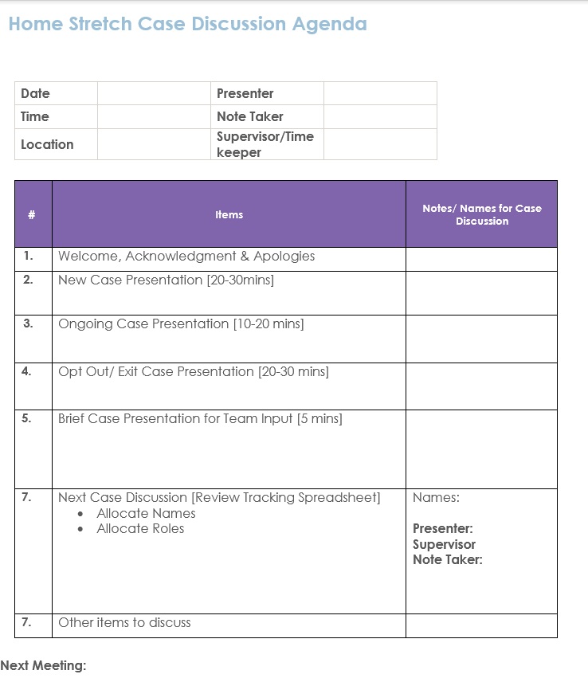

Slide 12
